Slide 1
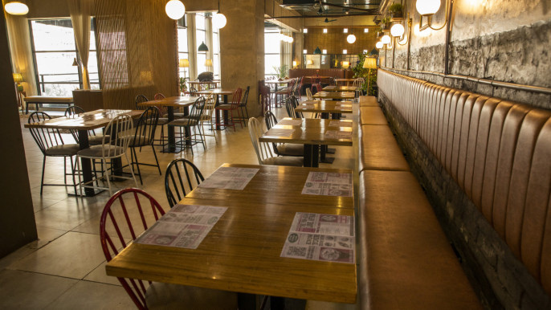

বাঙালিয়ানা
আপনার প্রিয় বাঙালি রেঁস্তোরা

Slide 2



THE TEAM
Rakibul Hoda Labib
2154901001
Nabil Walid Rafi
2154901005
Sakib Mizan
2154901009

Slide 3
INTRODUCTION
1
2
3
4
Omnichannel Restaurant
Sells Only Bengali Food
Categorized Meals
Order From Home
5
6
7
Find Our location & Visit Personally
Provide Reviews Online
Online Customer Support

Slide 4

OBJECTIVES
1
To make an omnichannel restaurant
5
Make it easy to order food as per the time of the day
2
To implement the culture of bengali food
Database implementation for food, customer information & reviews
6
3
To provide food services online
Make it easy for customers to come to restaurant physically as well as order online
7
Make it easy to contact us over online
4

Slide 5
FUNCTIONALITIES
View Details of Food
View Categorized Menu
Provide Feedback
1
2
3
4
5
6
7
Order Food Online
View featured Dish
Contact Restaurant
Add Product through Adminstration

Slide 6






TnT
1
2
3
4
5
6
HTML
CSS
JavaScript
PHP
VS Code
MySQL

Slide 7
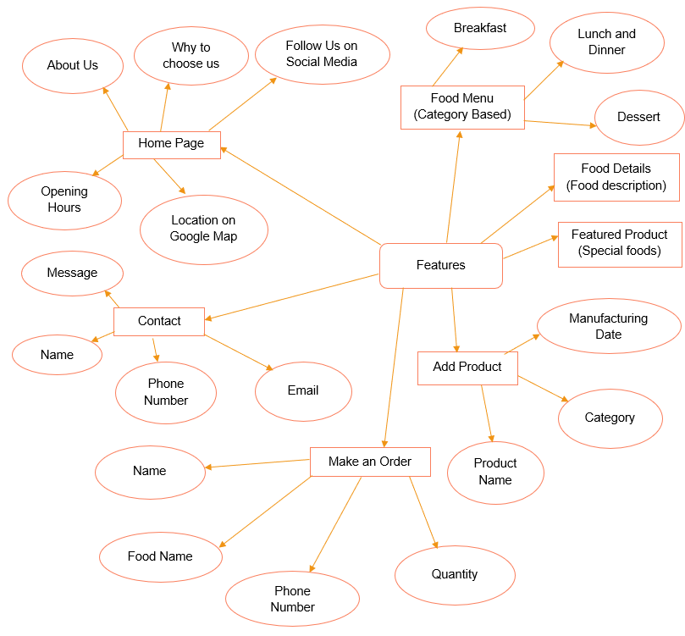
ER DIAGRAM

Slide 8
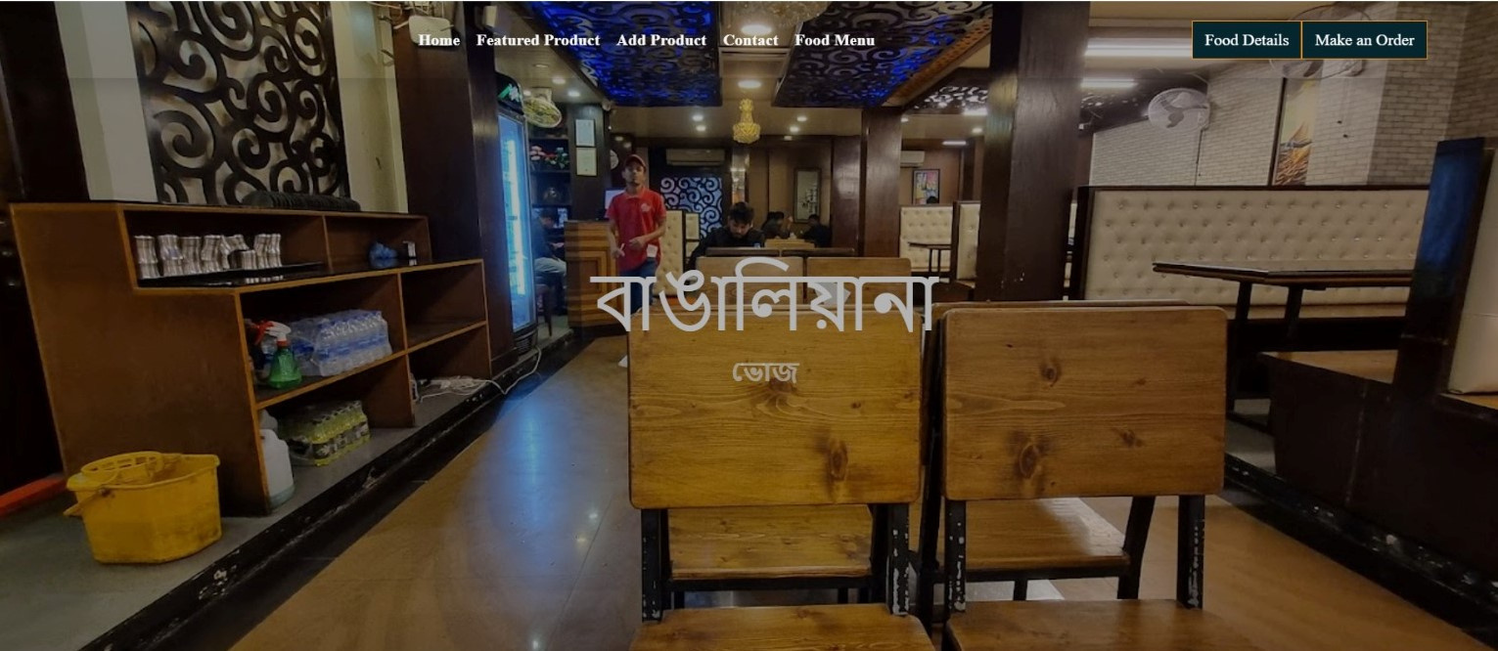
USER INTERFACE

Slide 9
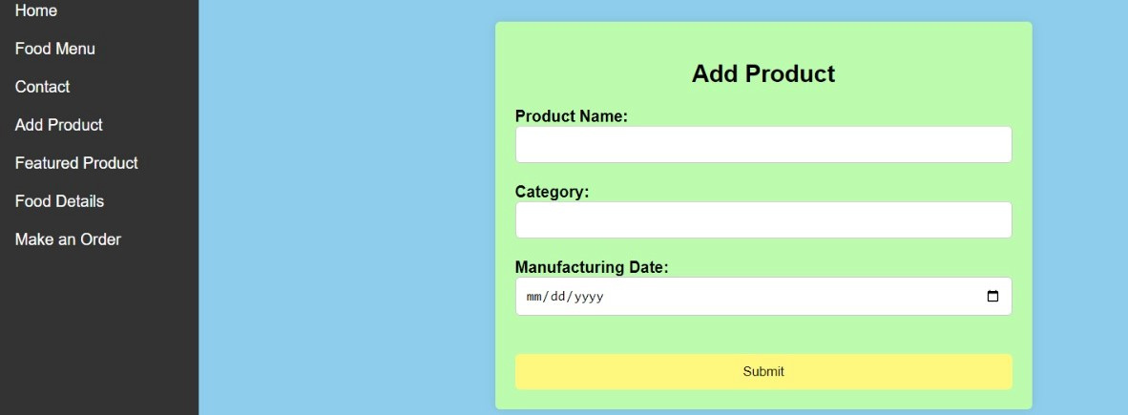
USER INTERFACE

Slide 10
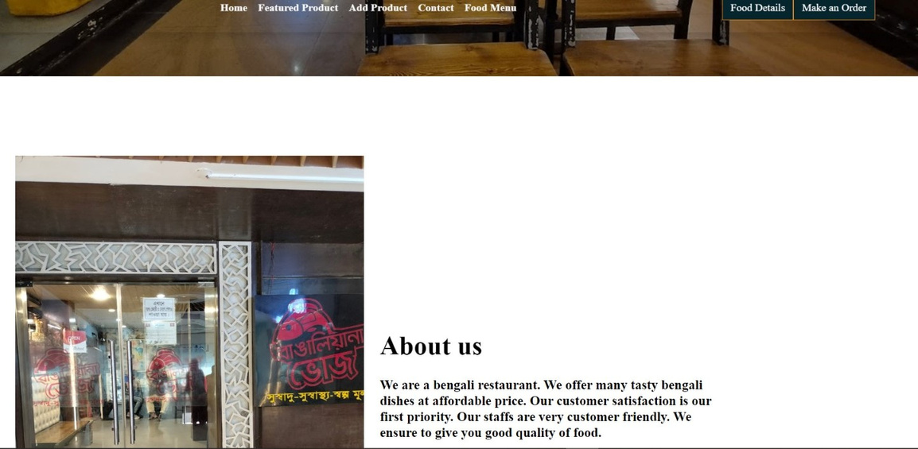
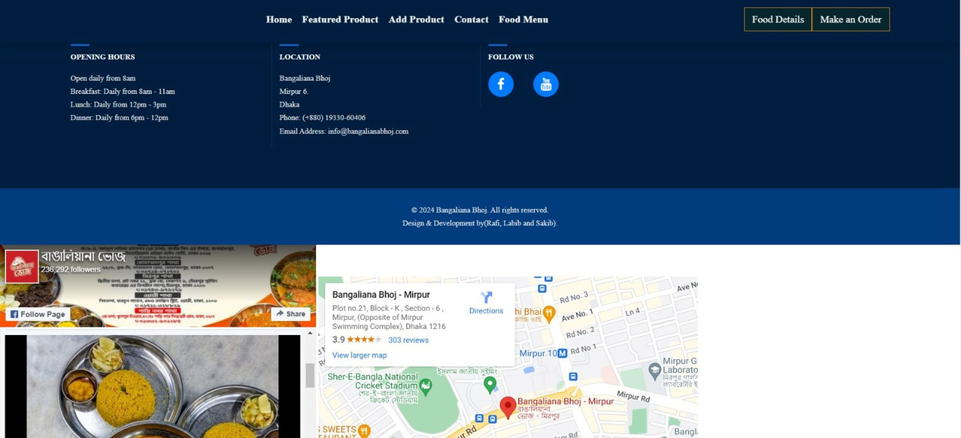
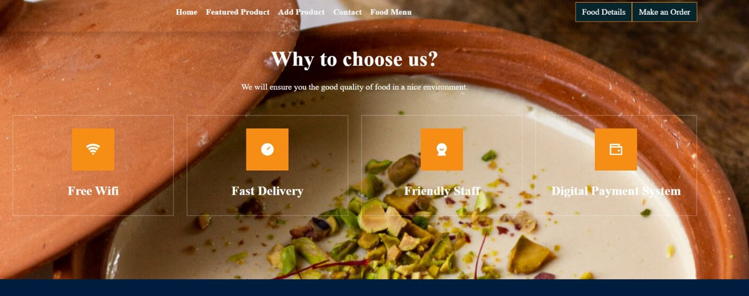
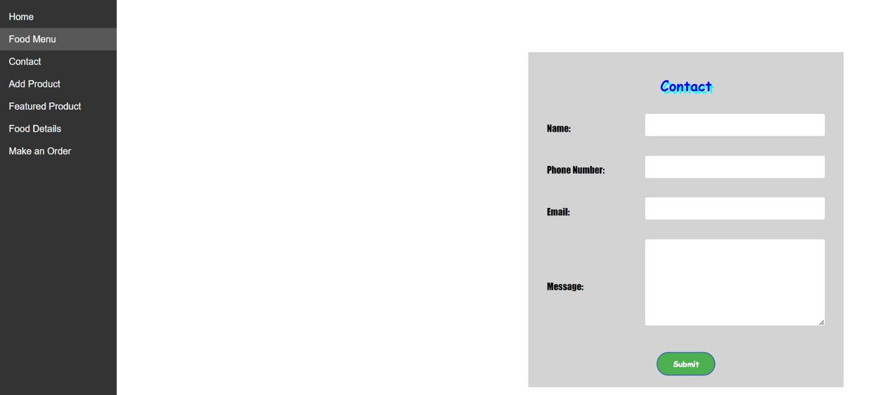
USER INTERFACE

Slide 11
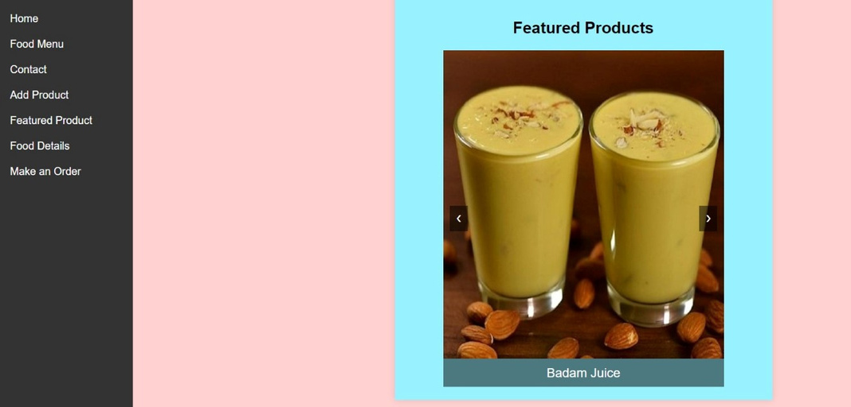
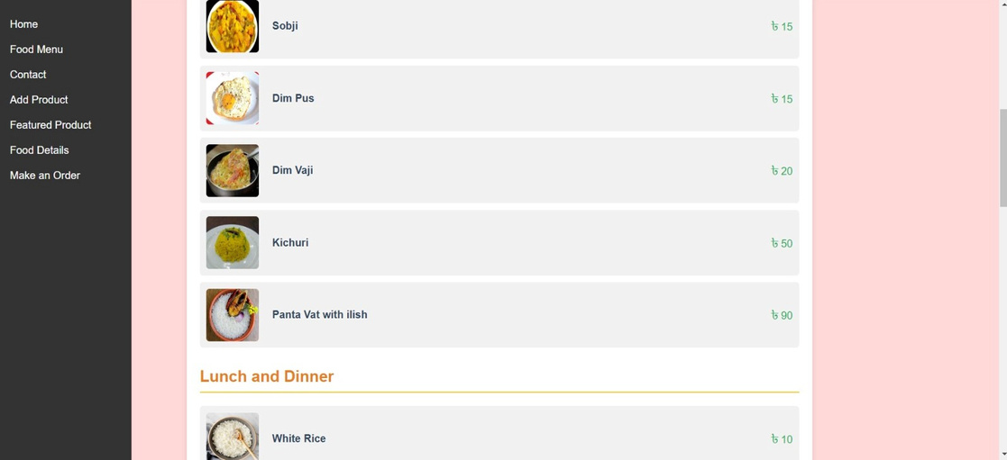
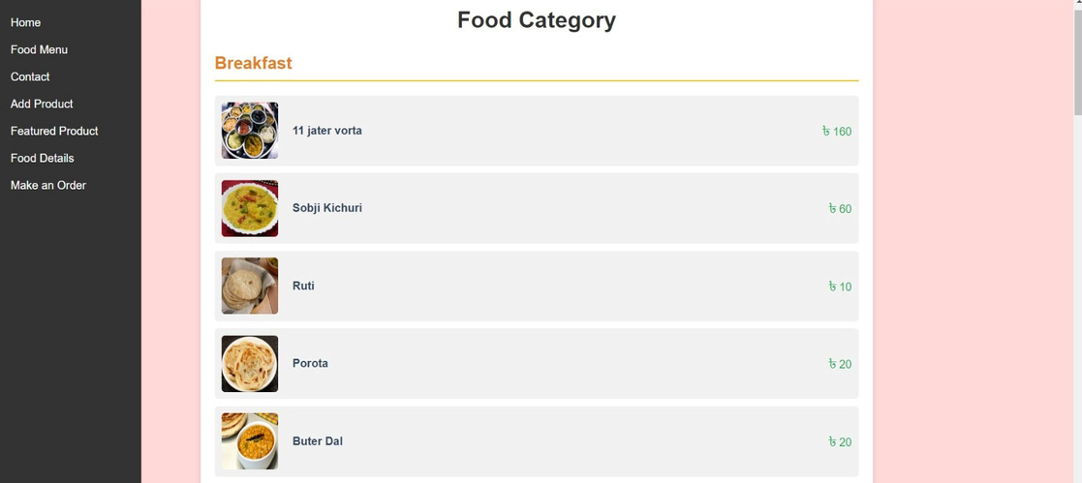
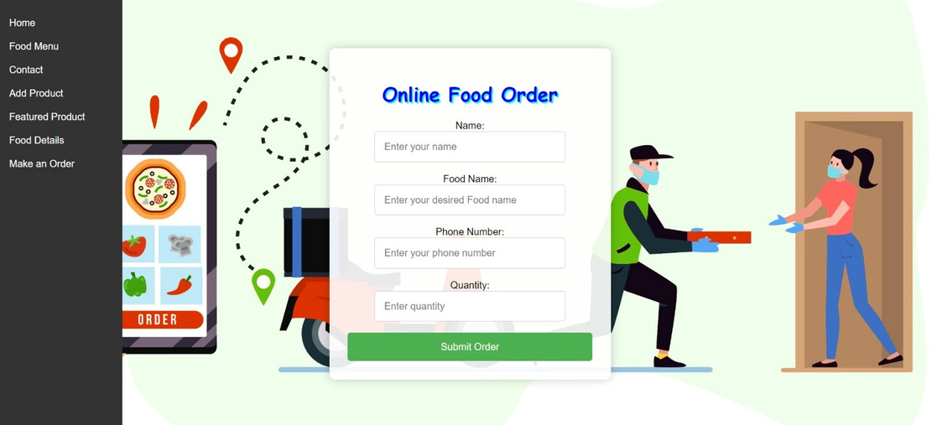
USER INTERFACE

Slide 12

CONCLUSION
HTML for the structure
Js to make the web pages interactive
Xampp to run the server
1
3
5
7
2
4
6
Used VS Code as the platform
PHP for the server side language
CSS to beautify the website
MySQL for the database

Slide 13


Thank You!
TEAM BANGALIANA

